Slide 1


Schmetterling
An 80% honest Dev story
by Ivan Kazandzhiev
Notes:
Once auo

Slide 2
Who am I?
I am 33-year-old guy with interest in just being better
If we do not know each other yet and you want to keep in touch: https://www.linkedin.com/in/ikazandzhiev/ or https://bit.ly/2SYvhI4
Notes:
I do not want to be gender specific :)
person, husband, son, friend, father, colleague and developer.

Slide 3

Notes:
The views and opinions expressed in this presentation are my own or I have copied and pasted them here.
They might not reflect how things work but this is how I perceive them. I am open minded which means I will make you see eye to eye
I am going for the brutalism design award with my weak sauce skills in visually organisation
Sit back, relax and do not worry we have only 60 slides left to go with code samples, questions to the audience and strong opinions :)
I hope I do not bore you to death

Slide 4
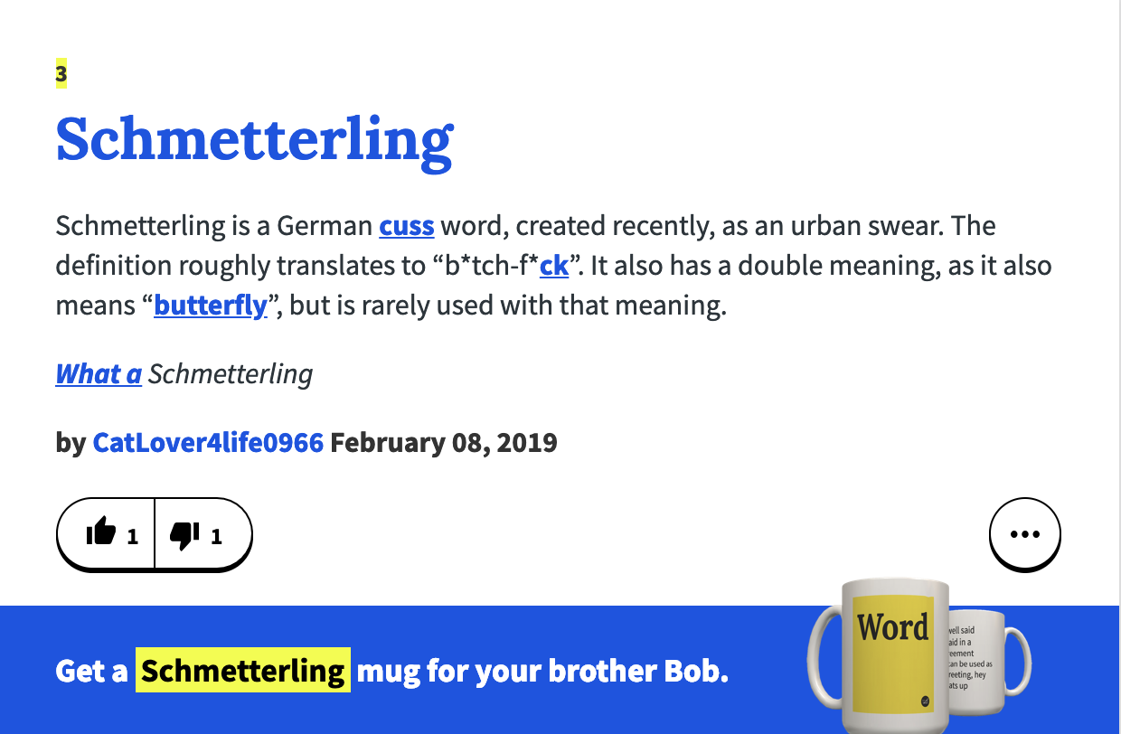
Notes:
Sooo, Der Schmeterling
The 4 stages

Slide 5
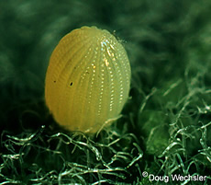



1. Egg
2.Caterpillar
3.Pupa
4.Butterfly
Notes:
Sooo, Der Schmeterling
The 4 stages

Slide 6
1. The Egg
I am originally from a small town in the Rhodopes mountain range.
At the age of 15 I was shipped out (even though not a minimal viable product) to the public.
After high-school he went on to the capital city Sofia to live the second most beloved Bulgarian dream: Study and eventually work: “Computers in Sofia”.
Notes:
Originally from a small town in the Rhodopes mountain range.
At the age of 15 I was shipped out (even though not even an MVP product) to the public. I was accepted to study english language in a different and bigger town called Pazardzhik.
I guess my parents were fans of the fail fast approach :)
After high-school he went on to the capital city Sofia to live the second most beloved Bulgarian dream: Study and eventually work: “Computers in Sofia”. University of Mining and geology
The first one is one is to be into politics and or to handle european projects.

Slide 7
1. The Egg
University years
Notes:
In the university I was pretty sure I would not make it as programmer but still I did not want to quit what I was doing because from all the other things I could try to do this seemed the most interesting to me. I did not have a real passion in the beginning and I blame C++ for it :). The first two years I have struggled a lot and I did not have any friends. The third year was a good one for me. After we hit web programming in our third year and after words Flash and ActionScript 3 there I found my interest in programming and we now had a common interest with several colleagues in web programming and university became more fun and interesting. I have started with PHP because the friends around me were using it and also it was really easy to do so(the more i say it the more it sounds like a drug :)
In the university I have also got a solid foundation on computer networking, databases, linux and microcontrollers. These topics I really liked and enjoyed.

Slide 8
2. Young caterpillar
1st job - Technical support
2nd job - University assistant for students’ lectures and exercises
Notes:
My first job I had it only a month: hosting support night shifts. I did not like working all night at all. I did not feel confident at all to start working as a developer and at the time computer administrator’s role seemed a lot interesting to me. I have started to work as a technical support in our university with really flexible working hours and really low pay. I stayed for several months where I quickly learned that computer administration is not interesting at all for me and I did my fair share of reinstalling windows os.
Meanwhile I was offered to be an university assistant to help out with lectures and exercises in my university and also to keep technical issues with computers out of the way. I have agreed and I promised myself it is going to be a good time to learn more upon what I have already known because I had to explain it to other people. This was really beneficial for me in the first one or two years but later, it became dissatisfied with myself. I felt there is a lot of repetition and I was stuck. one place. I did not have the chance to practice. I could not easily apply my knowledge practically and speak from experience.
So naturally I have decided to get a second job where I can practice. Thankfully this happened really quick. I had a lot luck starting as a one person dev team for a small HR company. I was doing all kinds development. II was keeping linux server up, auto-filling forms on websites, scraping web content, developing websites on wordpress etc… To this day I am so grateful for this first real development job. It showed me that I want to grow in this area, it showed me that I have not wasted my time so far and I have applied all gathered experience during my university work. In there I have worked 4-6 hours a day with just bathroom breaks. No coffee talk, no conversations it was a time for me to grow and learn new things.

Slide 9
2. Adult caterpillar
3rd job - Web developer (part-time)
4th job - Web developer (PHP full time)
(Do not count as a job)Tried to be a freelancer for several months: I think I did it too early in my career and I really did not enjoy it. I like working among real people.
Notes:
So naturally I have decided to get a second job where I can practice. Thankfully this happened really quick. I had a lot luck starting as a one person dev team for a small HR company. I was doing all kinds development. II was keeping linux server up, auto-filling forms on websites, scraping web content, developing websites on wordpress etc… To this day I am so grateful for this first real development job. It showed me that I want to grow in this area, it showed me that I have not wasted my time so far and I have applied all gathered experience during my university work. In there I have worked 4-6 hours a day with just bathroom breaks. No coffee talk, no conversations it was a time for me to grow and learn new things.
After an year more working like that I have decided to go web development full time. I really liked JavaScript and PHP as languages of choice. I have applied to several companies and a lot of them were not interested in me. There were two that called me for an interview and from one of the companies I have received and offer to come and join as a PHP developer.
There I have spent my first year of coding full time.
I was so scared that people would learn that I am some kind of imposter that I had luck on the interview and so on. We were going to work with SVN for whatever that meant (I was using mercurial to learn about version control). Afterwords I understood there would be a code review process and I was so assured that I will be let go soon enough. At that early point of my career I took code reviews so personally that my whole day was ruined after some code review comments. Poor fool me, I was so taking code review feedback so wrong. Thankfully the other dev I was mainly working with so really a nice and knowledgeable person. He said a couple of good things and helped me out to see that the process of giving eachother feedback for our code is very important for our professional growth.
At some point I was learning a lot about JavaScript and started to really want to work in this area so I have decided to switch.

Slide 10
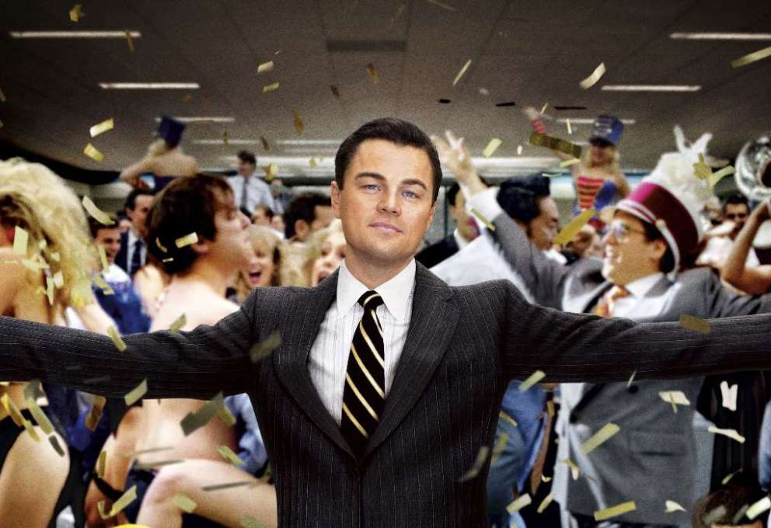
3. Pupa - The transformation within
6th job: A very big company that buys you a car after some years(trying to be as vague as possible)
Notes:
When I have passed all the interviews and asked for humble salary number and was given a higher number and a lot of benefits this is how i felt.
And here we come to the beginning of my best part of my career.: The crown jewel of all things socialism - above average pay, social benefits, lavish christmas parties :) Laptops and home offices options, great free coffee, free lunch, trainings etc…
At later point in your career you see that none of it matters so much as the people you are working with, and oh boy I have huge amounts of luck in this area. One of the best people and developers I have met so far in my life :)
The atmosphere there was “me” friendly. I felt that I belong I was getting better at what I do because of the people I have worked with the most there, I got a lot of good lessons for development, attitude towards people, friendship and life in general.
Right there I have found a great non-pressure environment to grow and become better.
Put lets put some faces of to the people I am talking about

Slide 11
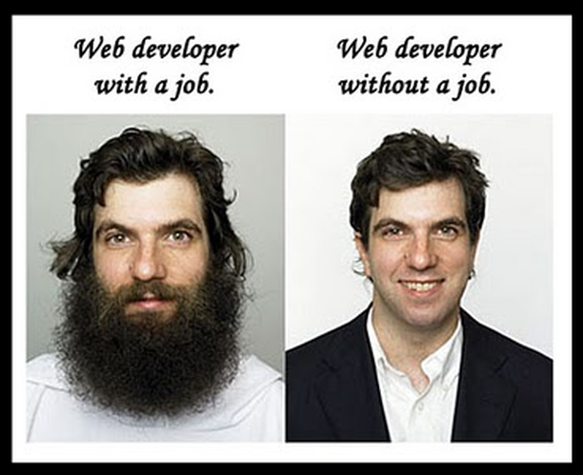
3. Pupawithin
Do you remember this one:
Notes:
Keep it in you mind

Slide 12
3. Pupa
These guys were my growth and support heroes(exclude me of course): Adrian
(not Andrian)
Niki
Krasi
Me
Adrian
(not Andrian)
Deyan
(Dido)
Notes:
We were obviously really busy as you can see by our beards which are not fake for sure. These 4 guys around me really shaped me as the developer I stand before you. The most thing I have learned in my career,
The 5 of us move from SAP to EPAM and only two of us are in here. To continue to grow in our career.
Make a joke about how serious Java developers are: because they have to write so much more code and types and interfaces and so on so that they do not have time to watch funny movies on the internet

Slide 13
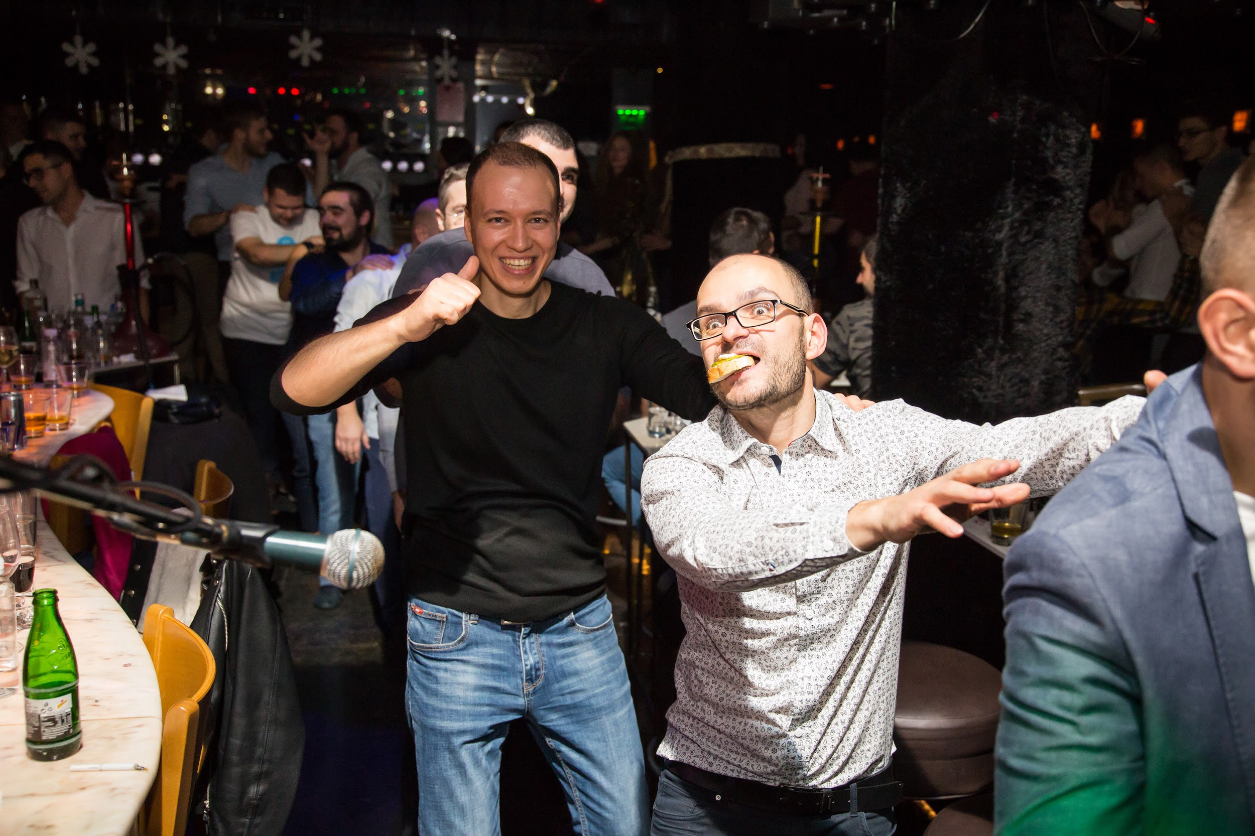
3. Pupa
7th job: EPAM
Notes:
In here I have spend one of the most dynamic and interesting three years of my life. I have met so many nice colleague that I was able to successfully work in a team and have fun with during our breaks or while stuck. EPAM managed to gather a lot of really nice people and great developers to learn from. Too bad that a lot of them are not here anymore.
From different kinds of projcets
I had the pleasure to work with Boby in a lot of projects which in my opinion is the fastest Jira to Code convertor I have worked with and also a great friend and helpful colleague during most of my time here. Sam with his mad skills, resourcefulness and his positive attitude (I believe he has a twin brother and they switch or at least he is cloned to be able to do so much work in so little time)
Ivaylo Zhekov and Nikola Kalinov: thought me that there is no task too tough to break you :)
I had the pleasure to be acting as a team lead in a recent project with KNAB and I am so thankful to Sam that approached me with this opportunity and the great team that was welcoming and helped me along the way and had the patience with me.
Name a few from the audience
I for sure will not praise everyone that was part of my journey and I am sorry about it

Slide 14
My favourite thoughts on software development and life
(in randomised order)
( I am not a licensed life coach so use with caution at your own risk)
(A lot of the times I do not follow these. Why? Because that is none of your bidness)

Slide 15
First let me point out that I am big fan of the 80/20 rule (Pareto principle).
80% percents of the bugs are produced in 20% of the code
80% percent of the time in SCRUM team is spent on processes and 20% in coding
80% is spent in reading code and 20% in writing it
80% of this presentation was looking for memes and 20% was spent on content, sadly
80% percent of the Javascript developer are cool and only 20% from Java developers are cool
You can go on and on
Notes:
Vilfredo Pareto

Slide 16
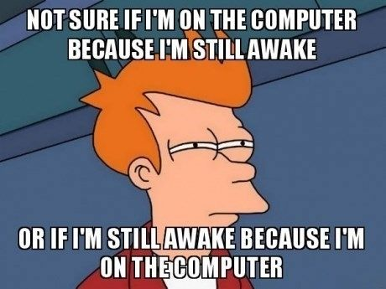
Stay up to date
Notes:
Stay up to date on your main skills. Be curious. Read a lot about your area of interest either FE or BE or Business, etc... and a little bit of what is not in your area of expertise.

Slide 17
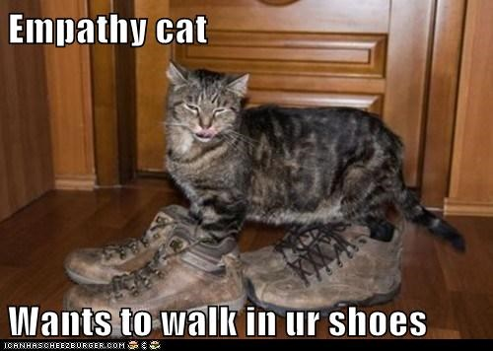
Empathize
Notes:
Everyone has bad days, is going through some rough patch in life, But still use the 80/20 rule. Do not read much into a person's bad mood or attitude it is not always about you, you narcissist,

Slide 18
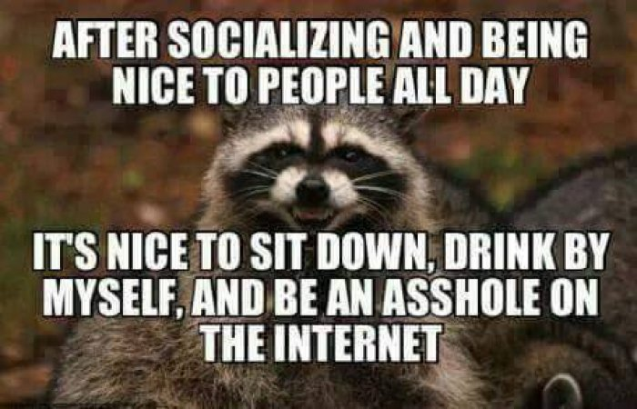
Be nice
Notes:
Be nice to people, give them the benefit of the doubt. User your smiley muscles more often and you will see that it helps to loosen up the atmosphere. (Learned that from my mom)
And you can do the second line at home to chillax

Slide 19
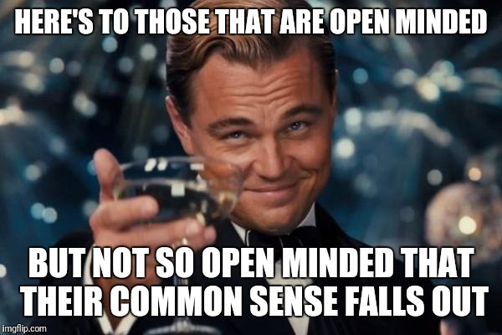
Be open minded
Notes:
Do not judge people so harshly :) But do not be a doormat

Slide 20
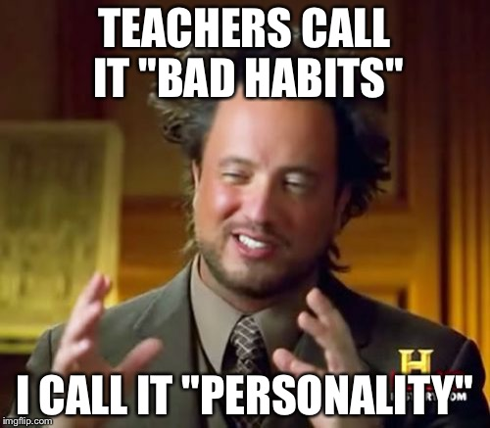
Habits
Notes:
You can improve a lot of aspects of your career. Maybe you should start with one and make it stick. I would like to think of it it is like a lego you build your whole life. And yes there will be days you skip on a routine and that is fine.totally fine. It does not diminish your

Slide 21
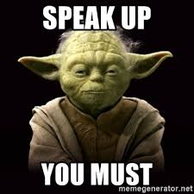
Speak up!
Notes:
Make sure you speak up your thoughts when discussing something or in a meeting. Do not be shy and do not be afraid of looking stupid. If you are right, you get to help out and teach something to someone and if you are wrong you will learn something.

Slide 22
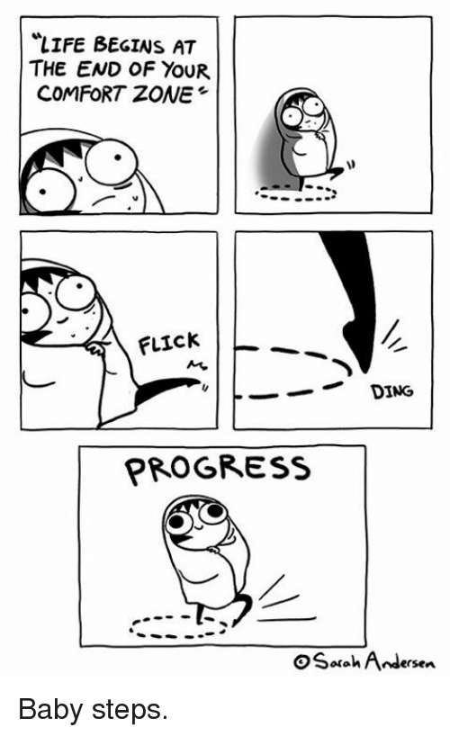
Jump in(and out of your comfort zone)
Notes:
It is good to get out of your comfort zone. Volunteer to present something, to organize and lead a meeting, take part in Interviews, make a presentation.

Slide 23
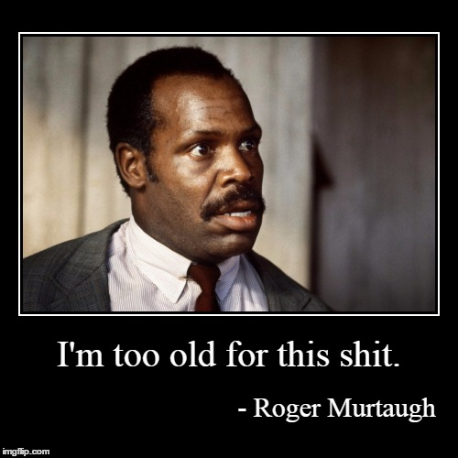
Everyone’s approval
Notes:
So it has been a while and I am not certainly twice as good as I used to be but my age made me more ignorant about what others would think and perceive of professionally, to some people I might suck technically but this is what I have to offer. I try to improve myself I try to be positive and help others as much as I can and this makes me feel good and contempt with myself to the point where I do not need to have everyone’s approval.

Slide 24
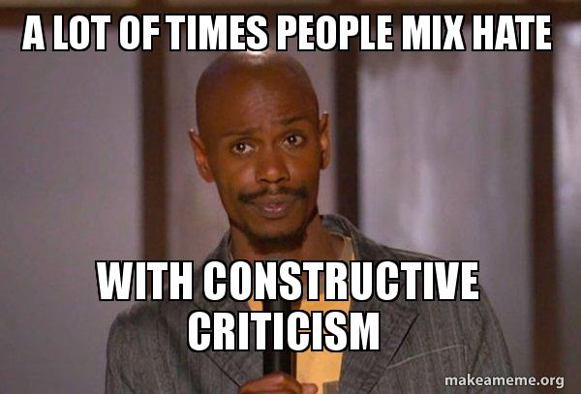
Criticism
Notes:
Accept Criticism - Criticising your code is not a critique of you and your personality. You are not your code, don’t take it personally it is just code. You need this so you can become better. The world of software development is not an easy one, especially if you have other things on your mind (we all have baggage) :)

Slide 25
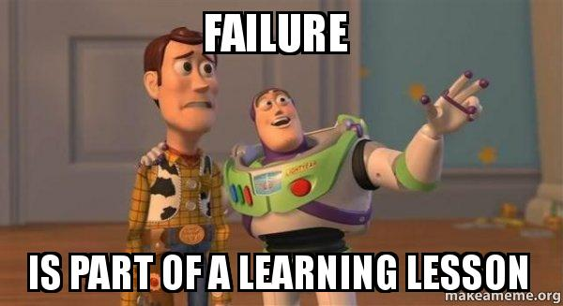
Failure
Notes:
Failure brings humility. It develops your character. It helps you laugh at your mistakes and not take things so seriously.

Slide 26
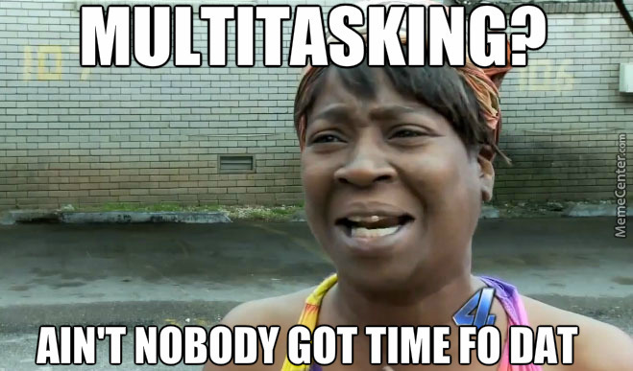
Multitasking
Notes:
I like to multitask if I have 1-2 challenging tasks on my plate. I will try cleanup requirements and try a thing or two in each direction and let it rest for a day or two(if I have the time). I would then will have an aha moment implement those thinking I did great. And on the next morning, I would say what were you thinking :D

Slide 27
Aaand some other ones
From now and then start a conversation with some colleague. Ask them about their project and maybe you will find a friend
Never be fully satisfied
First solutions are almost always not the best
Try to avoid toxic environments as much as possible it builds character but it harms your professionalism
Approach and learn from people you value and keep in high regard, they most likely will be happy to help. Ask for help and/or opinions
Notes:
And remember work is work, it will get done one way or another but having a positive attitude towards people that is the key to a more successful and less stressful career.

Slide 28
No one is self-made!
Notes:
Always be grateful to and for the people around you!

Slide 29
Notes:
I am definitely not there yet and I am not sure if I will ever get there...
I hope I stay for a bit while in the stage 3 of the butterfly because it is really nice and being at stage 4 only means there might be a “dead end” pun intended.

Slide 30
Closing notes:
Have fun and live and work responsibly :)
Ако има нещо, няма нищо (If there is something, there is nothing)
Книга за похвали и оплаквания: http://armenskipop.com/
#beshemipriatno #prodyljavamenapred #hashtag
Notes:
You are living in a country that has its flaws and good sides. You have access to cheap healthcare, drinking water, electricity, coffee, any type of food, good internet that is not regulated and you as a dev you are a in a very good social status and can afford a lot in Bulgaria, do not take for granted and do not behave like a drama queen when you have comments on you next merge request :)
Приятно дълъг уикенд!

